Slide 1

Container Orchestration on AWS: ECS vs. EKS
Wolfgang Unger, Krasimir Dzhigovechki NTT DATA Germany 15 May 2019
Notes:
While ECS is quite established and well supported on AWS, EKS was launched much later, to finally support Kubernetes on AWS. We want to show up the differences between ECS and EKS, talk about advantages and disadvantages of both solutions and point Out to you, in which situation or use case you should choose the one or the other.

Slide 2



Container Services on AWS
ECS
ECS Fargate
EKS
Notes:
Wir planen eine Demo über die drei Services zu Machen
Wir zeigen wie man Container auf die Orchastration Services zum Laufen bringt

Slide 3


History
2013
Docker
2014
Kubernets
1st GitHub commit
2015
Amazon ECS
Elactic Container Services
2017
Amazon ECS Fargate
Elactic Container Services
2018
Amazon EKS

Slide 4
ECS
Deep integration with AWS platform ALB, Auto Scaling, Batch, Elastic Beanstalk, CloudTrail CloudFormation, CloudWatch Events, CloudWatch Logs, CloudWatch Metrics, ECR, EC2 Spot, IAM, NLB, Parameter Store and VPC)
Scales to support clusters of any size
Service integration (like ALB, NLB) at container level
Maintains application availability
Amazon ECS is a highly scalable, high performance container management service that supports Docker containers and allows you to easily run applications on a managed cluster of Amazon EC2 instances.

Slide 5
Fargate
No infrastructure management required
Manage everything at container level
Lunch quickly scale easily
Resource based pricing
No provisioning, patching, cluster capacity management
AWS Fargate is a compute engine for deploying and managing containers, which frees you from having to manage any of the underlying infrastructure

Slide 6

IT’S DEMO TIME

Slide 7
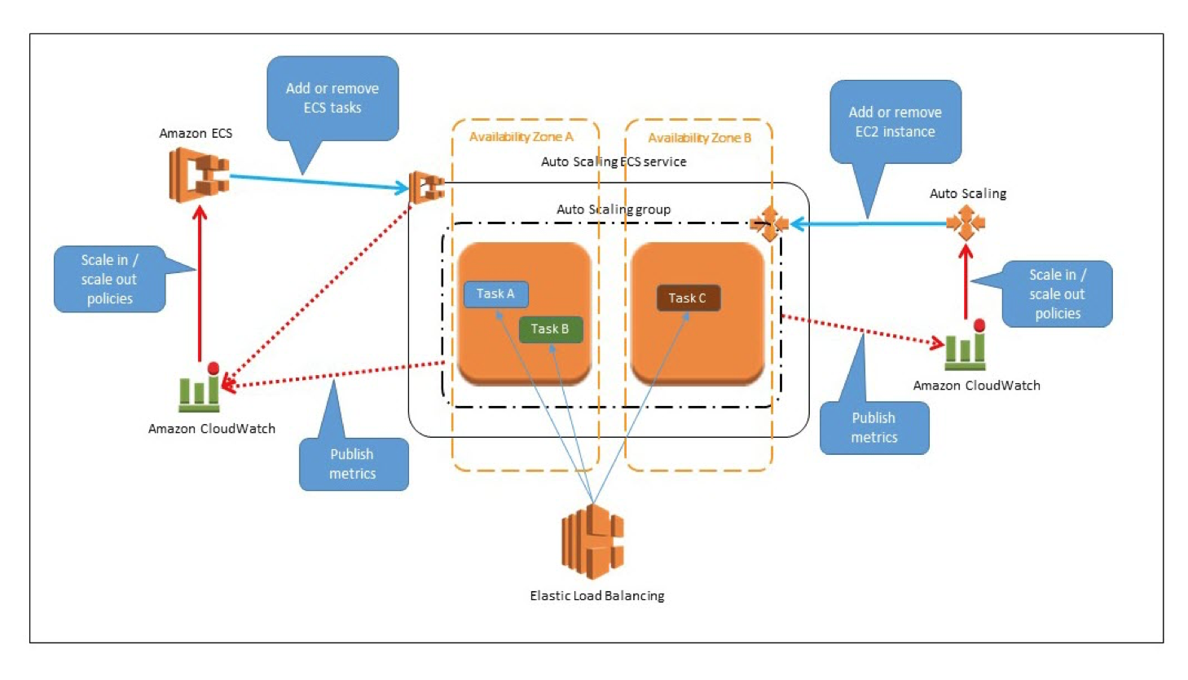
ECS Architecture

Slide 8
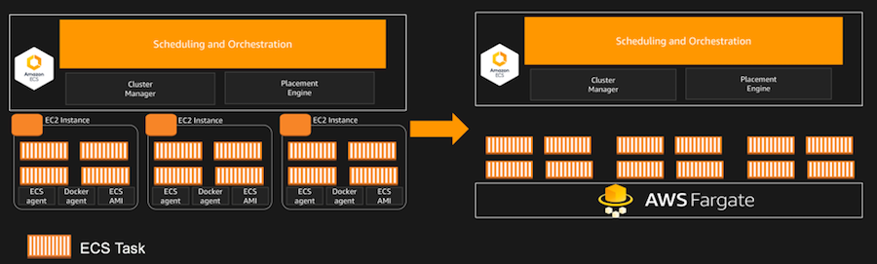
ECS vs Fargate

Slide 9



Slide 10

What is Kubernetes?
Open source container management plattform
Helps you run container on scale
Gives you primitives for building modern apps

Slide 11
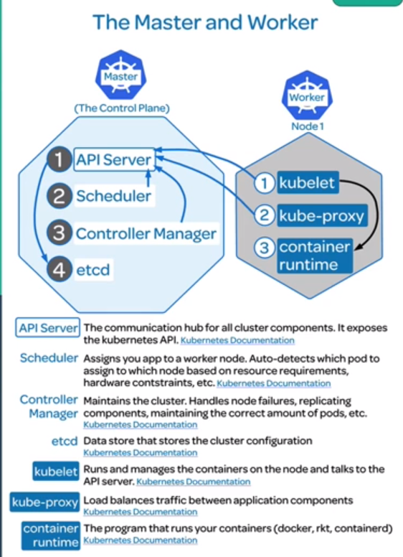
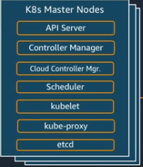

Amazon EKS
c
Managed Control Plane
Managing the API Server
The Cloud Controller Manager
The Scheduler
etcd the persistent storage used by kubernetes
Integrated with other AWS Services
You need to manage
worker nodes
Elastic container Service for Kubernetes (EKS)

Slide 12
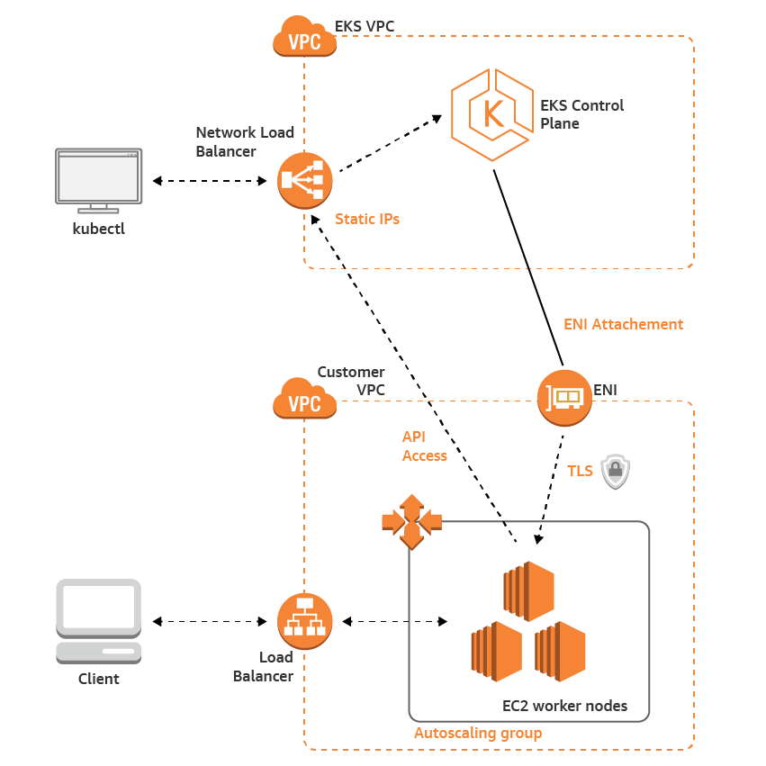
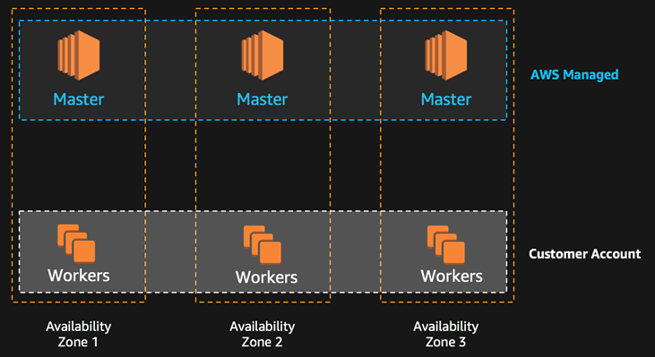
Amazon EKS

Slide 13
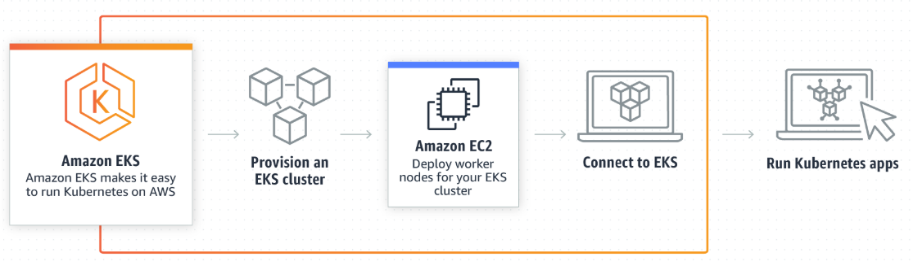
How it works?
Notes:
When you create an EKS cluster it actually goes through some steps
Setup your environment
Deploy VPC, subnets, internetGateways, anything needed to make EKS work
CloudFormation templates in the getting started guide
After that you‘ll create an EKS cluster
This is the highly available control plane
It‘ll configure all of the private key infrastructure
It‘ll setup ingress into that control plane
And give you that CNAME
After that you can provision your worker nodes
This instances live within your EC2 console and are managed ba an ASG that you are able to control
This means you can easiely grow and shrink your cluster to your own needs.
Lunch workloads
Once the worker nodes are up, you can deploy any container you‘d like any operator you‘d like etc.

Slide 14

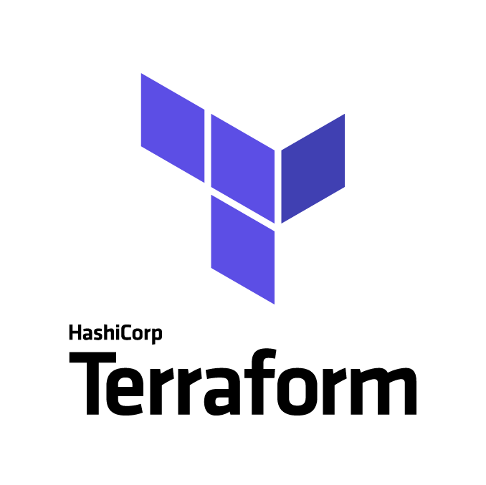

How to get started?
CloudFormation
eksctl
Terraform & Others
c
…
Notes:
When you create an EKS cluster it actually goes through some steps
Setup your environment
Deploy VPC, subnets, internetGateways, anything needed to make EKS work.
You need also to tag the VPC and its subnets to make them visible to EKS.
CloudFormation templates in the getting started guide
After that you‘ll create an EKS cluster
This is the highly available control plane
It‘ll configure all of the private key infrastructure
It‘ll setup ingress into that control plane
And give you that CNAME
After that you can provision your worker nodes
This instances live within your EC2 console and are managed ba an ASG that you are able to control
This means you can easiely grow and shrink your cluster to your own needs.
Lunch workloads
Once the worker nodes are up, you can deploy any container you‘d like any operator you‘d like etc.

Slide 15
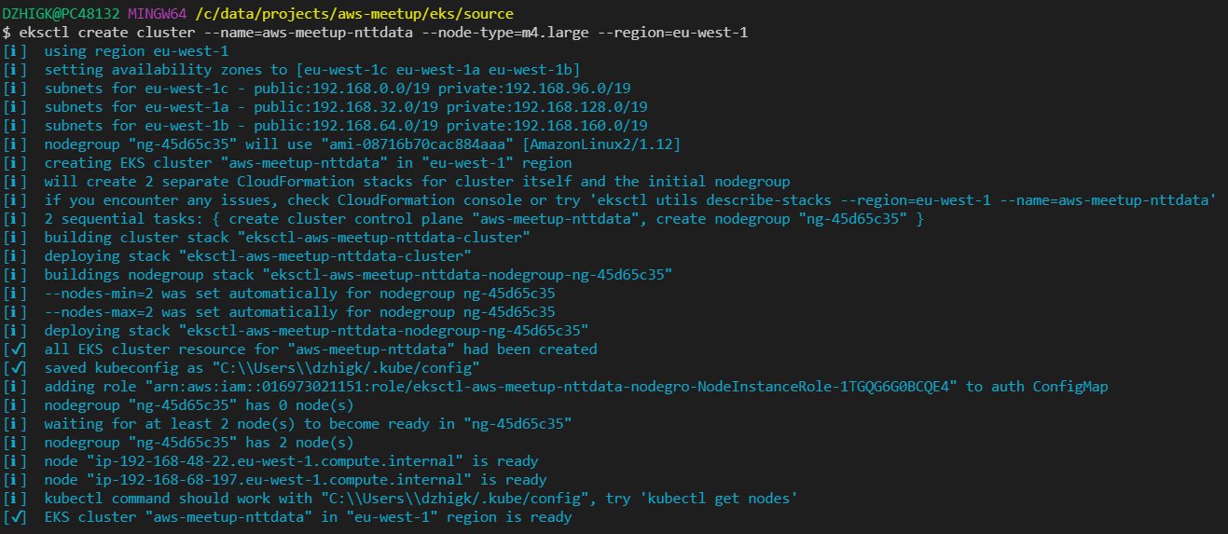
eksctl

Slide 16

Helm
c
Charts - are the Helm’s deployable artifacts.
Release - specific instance of a chart which has been deployed to the cluster
Respository - splace where charts can be collected and shared
helm search wordpress
helm install --name wordpress stable/wordpress
helm delete wordpress
The package manager for Kubernetes

Slide 17

Jenkins X
Automated CI/CD
GitOps
Pull Request Preview Environments
Promotions
Feedback on Issues and Pull Requests
DevPods
The Cloud Native Butler for Kubernetes

Slide 18
Jenkins X
c
Automated CI/CD
GitOps
Pull Request Preview Environments
Promotions
Feedback on Issues and Pull Requests
The cloud native butler for Kubernetes

Slide 19
IT’S DEMO TIME

Slide 20
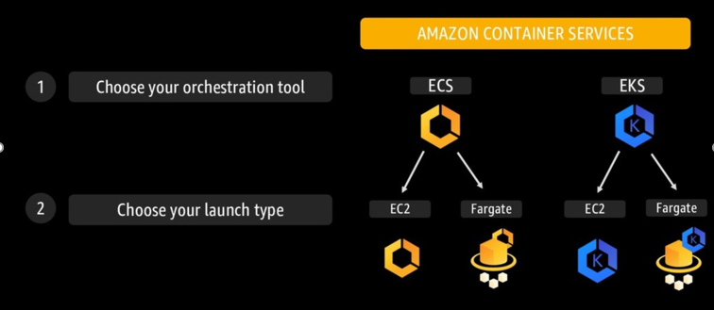
Containers on AWS: How to proceed?

Slide 21
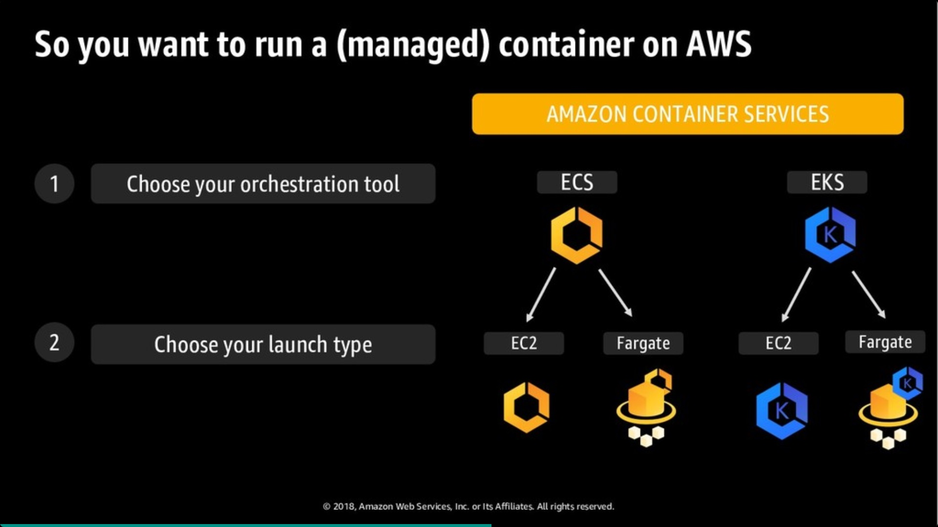
Notes:
Nachbauen

Slide 22
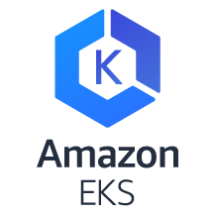


Comparision
Maturity of AWS integrations | low | high | high
Vendor Lock-In | low | high | high
Operational effort | high | medium | high

Slide 23
Comparision
Infrastructure components
VPC, Subnets
NAT Gateways
Security Groups (Host & LB)
Loadbalancer
EC2 instances
VPC, Subnets
Loadbalancers
Security Groups (LB)
VPC, Subnets
NAT Gateways
Security Groups (Host & LB)
Loadbalancer
EC2 instances
ECS
Fargate
EKS

Slide 24



Comparision
Operational Responsibility
More
opinionated
 | Data source integrations Physical hardware, software, networling and faiclities Provisioning | Application code
 | Container orchestration, provisioning Cluster scaling Physical Hardware, host OS/kernel, networking and facilities | Application code Data source integrations Security config, network config, firewall
 | Container orchestration control plane Physical software hardware | Application code Data Source integrations Security config and updates, network config, firewall Cluster Management
 | Physical hardware, software, networling and faiclities | Application code Data Source integrations Scaling Security config and uodates, network config, firewall, management tasks Provisioning, managing scaling and patching of sever
AWS Manages
Customer Manages
AWS Lambda
Serverless functions
Serverless containers
ECS
EKS
Container-management as a service
EC2
Less
opinionated
Infrastructure as a service
Notes:
https://gitlab.ballpark.altemista.cloud/bmw-technology
Issue Tracker
Board

Slide 25
Comparision
Costs
Pay per EC2 instance
Pay per Service usage (CPU and Memory)
Pay per EC2 instances
Pay additionally 20 ct. per hour.
ECS
Fargate
EKS
Cost optimisation by:
cluster size definition
instance type
price model (reserved / on-demand / spot)
Cost optimisation by:
cluster size definition
instance type
price model (reserved / on-demand / spot)

Slide 26
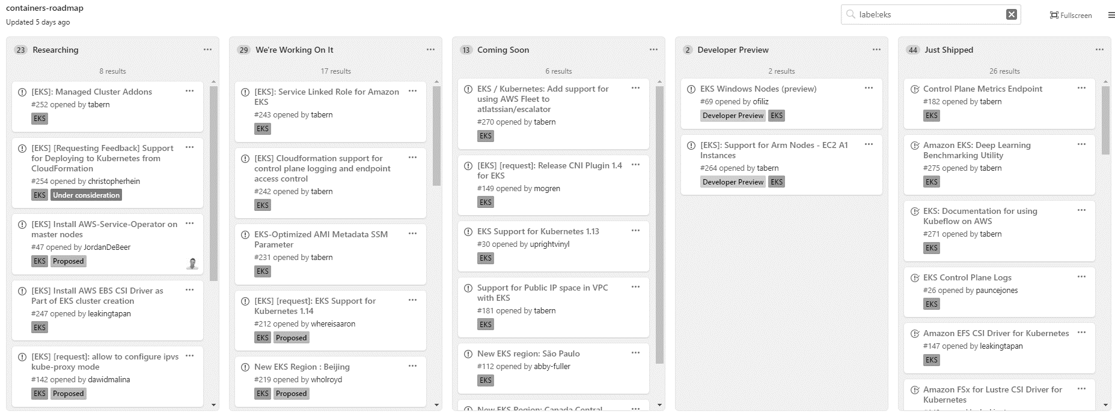
Roadmap Containers
Notes:
https://github.com/aws/containers-roadmap/projects/1?card_filter_query=label%3Aeks

Slide 27

THANKS. Q?

